Slide 1
Battle of Neighborhoods
Serkan güre

Slide 2
SCOPE
New Restaurant location with Socioeconomic Indicators and Foursquare API
01
Cluster analysis of locations using k-mean clustering
02
Identifying locations .
03

Slide 3

Python packages
Folium, Geopy, JSON, NumPy, Pandas, Requests, Sklearn

Slide 4
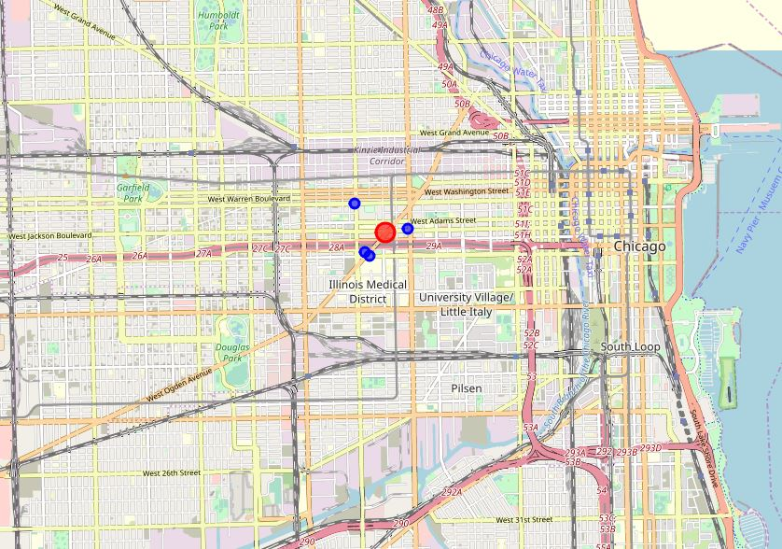
Locations
FOLIUM MAP

